Slide 1
© 2018 Cengage Learning®. May not be scanned, copied or duplicated, or posted to a publicly accessible website, in whole or in part.

Slide 2
Integrated Marketing Communications and Media Choices
12
© 2018 Cengage Learning.® May not be scanned, copied or duplicated, or posted to a publicly accessible website, in whole or in part.

Slide 3
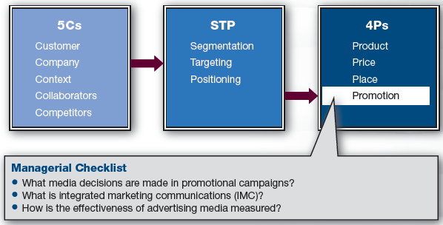
Marketing Framework

Slide 4
Discussion Questions #1
Name all of the media in which you have seen Kentucky Fried Chicken (KFC) promoted.
Why do you think these media were chosen?

Slide 5
What Media Decisions Are Made?
How much do we spend?
What is the schedule of expenditure?
Which media do we use as channels of our communications?

Slide 6
How Much to Spend (slide 1 of 3)
Percentage of sales
Percentage is determined by prior years’ sales or industry norms
Percentage is then adjusted depending upon this year’s goals

Slide 7
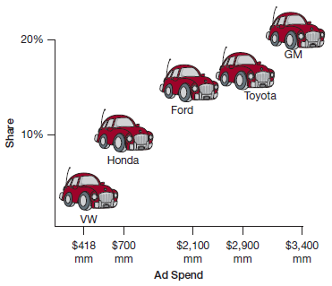
How Much to Spend (slide 2 of 3)
Competitive parity
Determine what competitors are spending
In some industries, ad spending is proportional to income

Slide 8
How Much to Spend (slide 3 of 3)
Strategic advertising goal
Set a strategic goal (awareness, attitude change, etc.) and then work backward to determine how much should be spent to reach the goal
Advertising is viewed as an investment that will return sales and profits
Need to understand reach and frequency

Slide 9
Reach, Frequency, and GRPs (slide 1 of 2)
Reach
The share of your target that has seen your ad at least once
Frequency
The average number of times target saw the ad (within set duration)
GRPs: Reach × Frequency
Ad reached 25% of target an average of 3 times—the ad delivered 75 GRPs

Slide 10
Reach, Frequency, and GRPs (slide 2 of 2)
For reach, the goal is to expose as many of the target customers as possible
Find the most cost-efficient media
Frequency depends on the goal
Awareness and memory—a few exposures
Persuasion may take more
Readily understood ads wear out quickly

Slide 11
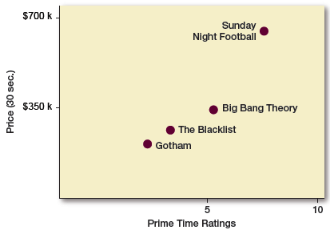
When to Schedule
It costs more to get higher ratings
However, the relationship is not perfect

Slide 12
When to Schedule: Concept in Action (slide 1 of 2)
Example
Big Bang Theory: 6.3 million TVs
$328,000 per 30 seconds
McDonald’s meal contribution: $0.50
$328,000/0.50 = 656,000 meals/breakeven
6.3 million viewers are exposed; thus, McDonald’s needs 10.4% to purchase
656,000/6.3 million = 10.4%
Is this reasonable?

Slide 13
When to Schedule: Concept in Action (slide 2 of 2)
Continuous: regularity in ad exposure
Occasional: pop up from time to time
Seasonal: infrequent and focused on the preterm season for the product
e.g., School supplies in August

Slide 14
Discussion Questions #2
When would you recommend advertising
Your school?
Oil changes?

Slide 15
Which Media (slide 1 of 7)
The choice of media outlet is difficult because…
There are more media outlets
e.g., More television stations, more radio stations via XM, and the Internet
Audiences are fragmented across the many media and use technology to zip past ads

Slide 16
Which Media (slide 2 of 7)
Integrated marketing communication
When advertising across media
Consider the company’s overarching strategy
Ensure a consistent message
All communications
e.g., Trade advertising, personal selling, direct marketing, and product placements
As well as other marketing mix elements
e.g., Product design, pricing, and channels
Play to each media’s strength

Slide 17
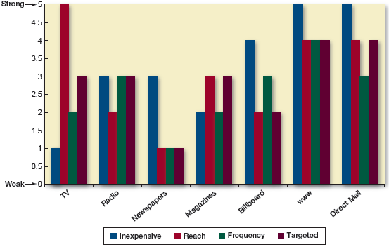
Which Media (slide 3 of 7)
Media Choices: Relative Strengths on Business Measures

Slide 18
Which Media (slide 4 of 7)
Media comparisons
TV ads
Most expensive; yield the largest reach; yield a broad not targeted reach; cable allows some targeting; frequency is expensive
Magazines
Have broad appeal or can be targeted
Radio and newspapers
Purchased nationally, but can be purchased for local markets

Slide 19
Which Media (slide 5 of 7)
Media comparisons
Billboards are relatively inexpensive; good for local coverage
Radio, newspapers, and magazines are less expensive than TV, but they also deliver smaller audiences
Magazines require long lead times for production; have good reproduction quality

Slide 20
Which Media (slide 6 of 7)
Media comparisons
Newspapers and magazines are nonintrusive; viewers can ignore ads
Online and direct mail can be customized
Online ads are inexpensive and can be targeted; Internet penetration isn’t 100%
Direct mail is relatively inexpensive and targeted; not efficient (junk mail)

Slide 21
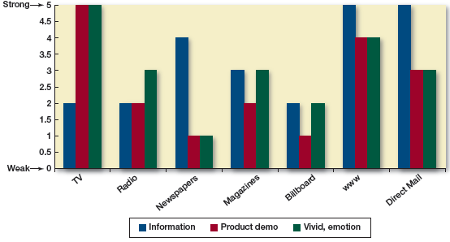
Which Media (slide 7 of 7)
Media Choices: Relative Strengths on Ad Content

Slide 22
Discussion Questions #3
Which media would you choose to advertise a new local restaurant? Why?
What should you consider to help guarantee an integrated approach?

Slide 23
Beyond Advertising
Personal selling
Is an essential communication vehicle
Accounts for 14 million jobs
Over 10% of workforce
Is especially important for expensive, complicated products

Slide 24
Designing a Sales Force (slide 1 of 2)
Questions to consider…
How many salespeople do I need?
More with an aggressive launch or to protect territories
Where do I deploy them?
How do I compensate them?
Salary and commission
Proportion determined by tradition and competition

Slide 25
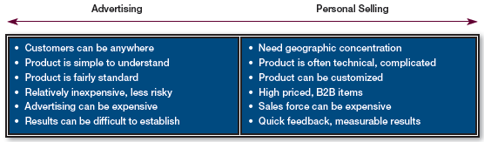
Advertising vs. Personal Selling
Choice Between Advertising and a Sales Force

Slide 26
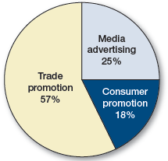
Discussion Question #4
Why do you think such a large proportion of the promotional budget is spent on trade promotion?

Slide 27
Designing a Sales Force (slide 2 of 2)
Pull strategies
Direct promotional efforts to consumers
Rely on advertising and sales promotions
Push relies more on personal selling
Direct promotional efforts to channel
Rely on trade allowances—price reductions to intermediaries for allocating space, etc.
May be passed on to retailer’s salespeople as cash, training and product demonstrations, free merchandise, conventions, etc.

Slide 28
Public Relations (slide 1 of 3)
Purpose
Provide information and build brand attributes
PR lines of communication are a company’s attempt to reach its constituency
Customers, suppliers, stockholders, government, employees, general community
Convey a positive image and educate a constituency about the company
Generate goodwill on behalf of the company

Slide 29
Public Relations (slide 2 of 3)
PR people
Issue press kits
Press releases for newsworthy occurrences (e.g., product launch), company information, bios, and history
Maintain company information on website
Arrange events (e.g., speaking engagements), sponsorships, and community philanthropy

Slide 30
Public Relations (slide 3 of 3)
Publicity
Is a communication tool the company does not pay for
PR can issue press releases, but there is no guarantee that they will be picked up
Can be negative or positive because companies cannot directly control it
Has the appearance of objectivity

Slide 31
Discussion Questions #5
Give an example of negative publicity that you think the company handled well.
Give an example of positive publicity and the potential benefits of this publicity.

Slide 32
Product Placement
Products are integrated into movies, TV shows, and video games
More subtle than ads
e.g., James Bond’s cars
Consumers can’t “zip” past them

Slide 33
Event Sponsorship
Occurs in sports and cultural or artistic endeavors
Brands draw from event’s positive valence and energy
e.g., Sponsoring NASCAR racing
Not clear if it is cost-effective

Slide 34
Sales Promotion
Activate purchase interest and influence short-term sales
Can entice customers to switch brands
Forms
Coupons, rebates, promotional pricing, trade-ins, loyalty programs, trials, contests, etc.

Slide 35
IMC Choices Depend on Goals (slide 1 of 2)
When determining which promotional method to choose, consider …
The target audience
The company’s goals
e.g., Awareness, information, preferences, purchase trial, and repeat purchase

Slide 36
IMC Choices Depend on Goals (slide 2 of 2)
Additional questions to consider
Should we schedule continuously, occasionally, or seasonally?
What is the consumer’s purchase cycle?
What is the level of saturation desired?
What life cycle stage is the product in?
What can we afford?
What is best for our target?
What do we want the target to know?

Slide 37
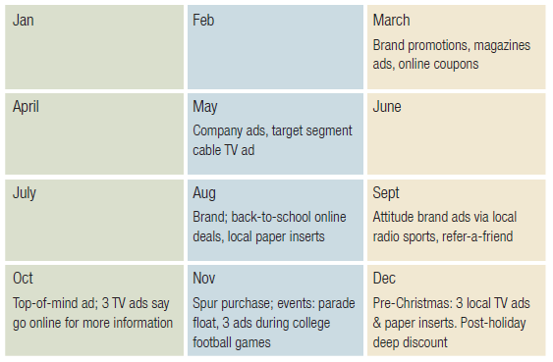
IMC Schedule

Slide 38
Assessing Media Effectiveness (slide 1 of 3)
If goal is awareness, reach matters
Measure viewership, readership, circulation numbers, traffic indices, etc.
If goal is attitudinal, use surveys
It can be difficult to assess ROMI because customers may not remember where they saw the ad

Slide 39
Assessing Media Effectiveness (slide 2 of 3)
Considerations
Increasing ad budget relative to competition doesn’t increase sales in general
Qualitative differences, such as better ad copy, can increase the likelihood of sales
Ads that evoke positive feelings have been related to sales
Some believe that ad budgets should not be spent on current customers who already prefer the brand

Slide 40
Assessing Media Effectiveness (slide 3 of 3)
Online advertising
Track click-thru rates, downloads, inquiries, purchases, returns, etc.
Compare with cost per click, per download, per acquisition, etc.
Online ad cost is low, but effectiveness is not great

Slide 41
Discussion Questions #6
If you are recruiting for the Army with the “Be All You Can Be” message
Which media would you choose?
When would you schedule the ads?
How would you measure effectiveness?
Beyond advertising, what other promotional methods might be effective?

Slide 42
Managerial Recap
Decisions about expenditure and timing are integral to promotional campaigns
Marketers must integrate marketing communications
The effectiveness of advertising is measured using long- and short-term measures

